Slide 1
BAC Test WebApp
Tan D. Duong - COSC 412-102

Slide 2
Project Overview
Started working in March 06. Last updated May 01
Built from scratch: HTML5, CSS3, JavaScript
Hosted and Registered domain by HostGator https://www.hostgator.com
Updated files by FileZilla https://filezilla-project.org
IDE: VS Code
Database connected using Firebase
Budget: $11/mo
Link: https://testbac.com
Source Code: https://github.com/tandduong/Breathalyser-App

Slide 3
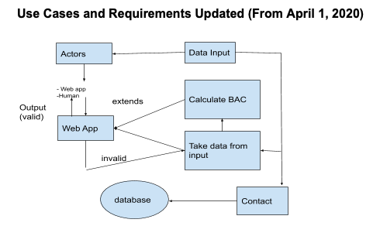
Test Plan

Slide 4
Test Plan (cont.)
Link to Test Procedure: https://github.com/tandduong/Breathalyser-App/blob/master/TestProcedure-Tan.pdf
Overview:
Changes of the backend plan
Dev Tools for the responsiveness
7-step test procedure
Final test after deployment

Slide 5
Deployment Plan
Domain name and host service from HostGator ($11/mo)
Test the index files by https://validator.w3.org
Upload files from FileZilla
Final Test

Slide 6
Project Purpose
Tools for users to test their Blood Alcohol Concentration (BAC)
BAC refers to percent of alcohol in person’s bloodstream
Project built to prevent the rate of drunk driving and its consequences
Free Web App
For Developer: to contribute to society and enhance skills.

Slide 7
https://testbac.com

